Slide 1
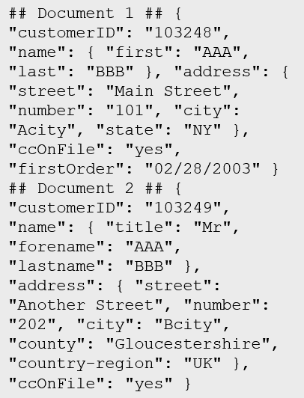
What is data?
Collection of facts, numbers, descriptions, objects , stored in a structured, semi-structured, unstructured way
Structured
Semi-structured
Unstructured
Table
Notes:
Instructor notes
Structured data is data that adheres to a schema, so all of the data has the same fields or properties. Structured data can be stored in a database table with rows and columns
Semi-structured data doesn't fit neatly into tables, rows, and columns. Instead, semi-structured data uses _tags_ or _keys_ that organize and provide a hierarchy for the data

Slide 2

Transactional vs analytical data stores
Online Transactional Processing (OLTP)
Online Analytical Processing (OLAP)
Customer
CustomerID | CustomerName | CustomerPhone
Orders
OrderID | CustomerID | OrderDate
Data is periodically loaded, aggregated and stored in a cube
Data is stored one transaction at a time
Notes:
Instructor notes
It is important to understand the distinction between OLTP and OLAP.
OLTP is typically a live system. Updates are made transactionally, for example, an order is placed. Each individual order is stored in the OLTP system.
OLAP is an aggregated system. Data is imported (often from an OLTP system) and aggregated. The aggregation will typically occur at different levels allowing you to drill down or up, for example from a company summary, to a department summary, to an employee town summary. Because OLAP data is aggregated periodically, once the aggregation has been performed, queries which need the summaries that it contains are very fast.
OLTP is good for many small updates that happen frequently. OLAP is good for large summarized queries that happen periodically.

Slide 3




Transactional workloads
Transactional data is information that tracks the interactions related to an organization's activities.
Atomicity – each transaction is treated as a single unit, which success completely or fails completely.
Consistency – transactions can only take the data in the database from one valid state to another.
Isolation – concurrent execution of transactions leave the database in the same state.
Durability – once a transaction has been committed, it will remain committed.
-$
+$

Slide 4



Analytical Workloads
Analytical workloads are used for data analysis and decision making.
Summaries
Trends
Business information
2020 Transactions
Notes:
Instructor notes
Analytical workloads are typically read-only systems that store vast volumes of historical data or business metrics
Analytics can be based on a snapshot of the data at a given point in time, or a series of snapshots.
An example of analytical information is a report on monthly sales.

Slide 5

Data Processing
Data processing is the conversion of raw data to meaningful information through a process.
Batch Processing: data elements are collected into a group. The whole group is then processed at a future time as a batch
Daily
Batch Job
All Input
All Output
Stream Processing: each new piece of data is processed when it arrives.
System Upload
System Upload
Input 1
Input 2
Notes:
Differences between batch and streaming
- *Data Scope*: Batch processing can process all the data in the dataset. Stream processing typically only has access to the most recent data received, or within a rolling time window (the last 30 seconds, for example).
- *Data Size*: Batch processing is suitable for handling large datasets efficiently. Stream processing is intended for individual records or *micro batches* consisting of few records.
- *Performance*: The latency for batch processing is typically a few hours. Stream processing typically occurs immediately, with latency in the order of seconds or milliseconds. Latency is the time taken for the data to be received and processed.
- *Analysis*: You typically use batch processing for performing complex analytics. Stream processing is used for simple response functions, aggregates, or calculations such as rolling averages.

Slide 6
Tables
Customers
CustomerID | CustomerName | CustomerPhone
100 | Muisto Linna | XXX-XXX-XXXX
101 | Noam Maoz | XXX-XXX-XXXX
102 | Vanja Matkovic | XXX-XXX-XXXX
103 | Qamar Mounir | XXX-XXX-XXXX
104 | Zhenis Omar | XXX-XXX-XXXX
105 | Claude Paulet | XXX-XXX-XXXX
106 | Alex Pettersen | XXX-XXX-XXXX
107 | Francis Ribeiro | XXX-XXX-XXXX
Data is stored in a table
Table consists of rows and columns
All rows have same # of columns
Each column is defined by a datatype
Notes:
Instructor notes
The main characteristics of a relational database are:
- All data is tabular. Entities are modeled as tables, each instance of an entity is a row in the table, and each property is defined as a column.
- All rows in the same table have the same set of columns.
- A table can contain any number of rows.
- A primary key uniquely identifies each row in a table. No two rows can share the same primary key.
- A foreign key references rows in another, related table. For each value in the foreign key column, there should be a row with the same value in the corresponding primary key column in the other table.

Slide 7
Normalization
Customers
CustomerID | CustomerName | CustomerPhone
100 | Muisto Linna | XXX-XXX-XXXX
101 | Noam Maoz | XXX-XXX-XXXX
102 | Vanja Matkovic | XXX-XXX-XXXX
103 | Qamar Mounir | XXX-XXX-XXXX
104 | Zhenis Omar | XXX-XXX-XXXX
105 | Claude Paulet | XXX-XXX-XXXX
106 | Alex Pettersen | XXX-XXX-XXXX
Orders
OrderID | CustomerName | CustomerPhone
AD100 | Noam Maoz | XXX-XXX-XXXX
AD101 | Noam Maoz | XXX-XXX-XXXX
AD102 | Noam Maoz | XXX-XXX-XXXX
AX103 | Qamar Mounir | XXX-XXX-XXXX
AS104 | Qamar Mounir | XXX-XXX-XXXX
AR105 | Claude Paulet | XXX-XXX-XXXX
MK106 | Muisto Linna | XXX-XXX-XXXX
Data is normalized to:
Reduce storage
Avoid data duplication
Improve data quality
Notes:
Instructor notes
1st Normal Form (1NF) – Each cell should only contain one value
2nd normal form (2NF) – Every non-key column depends upon the whole key
3rd Normal form (3NF) – Columns do not depend on any non-key columns
In the above example, in the Orders table, Customer Phone depends upon Customer Name which breaks 3NF. This is resolved on the next slide.

Slide 8
Indexes
Customers
CustomerID | CustomerName | CustomerPhone
100 | Muisto Linna | XXX-XXX-XXXX
101 | Noam Maoz | XXX-XXX-XXXX
102 | Vanja Matkovic | XXX-XXX-XXXX
103 | Qamar Mounir | XXX-XXX-XXXX
104 | Zhenis Omar | XXX-XXX-XXXX
105 | Claude Paulet | XXX-XXX-XXXX
106 | Alex Pettersen | XXX-XXX-XXXX
IDX-CustomerRegion
CustomerID | Region
100 | France
101 | Brazil
102 | Croatia
103 | Jordan
104 | Spain
105 | France
106 | USA
An index:
Optimizes search queries for faster data retrieval
Reduces the amount of data pages that need to be read to retrieve the data in a SQL Statement
Data is retrieved by joining tables together in a query
Notes:
Instructor notes
Use an analogy of a book index. Without the index, you would have to read the whole book every time you wanted to find something. The disadvantage of an index is that every time you update information in the book, you need to update the index.

Slide 9
Explore characteristics of non-relational data
Entities
## Customer 1 ID: 1
Name: Mark Hanson
Telephone: [ Home: 1-999-9999999, Business: 1-888-8888888, Cell: 1-777- 7777777 ]
Address: [ Home: 121 Main Street, Some City, NY, 10110,
Business: 87 Big Building, Some City, NY, 10111 ]
## Customer 2 ID: 2
Title: Mr
Name: Jeff Hay
Telephone: [ Home: 0044-1999-333333, Mobile: 0044-17545-444444 ]
Address: [ UK: 86 High Street, Some Town, A County, GL8888, UK,
US: 777 7th Street, Another City, CA, 90111 ]
Non-relational collections can have:
Multiple entities in the same collection or container with different fields
Have a different, non-tabular schema
Are often defined by labeling each field with the name it represents
Notes:
Instructor notes
Data doesn’t follow rules of relational data.
Because data can be loaded in its native form, it can be loaded quickly.
Very flexible and good for unknown data or queries.
Less good for known data structures and known queries.

Slide 10

Identify non-relational database use cases
IoT and Telematics:
Often require to ingest large amounts of data in frequent burst of activity, data is either semi structured or structured, often requires real time processing
Retail and Marketing:
Common scenarios for globally distributed data, document storage
Gaming:
In-game stats, social media integration, leaderboards, low-latency applications
Web and Mobile:
Commonly used with web click analytics, modern applications including bots

Slide 11
Types of non-relational data
What is semi-structured data?
Data structure is defined within the actual data by fields. Format/file types include:
JSON
AVRO
ORC
Parquet
Notes:
Instructor notes
A JSON document is enclosed in curly brackets ({ and }). Each field has a name (a label), followed by a colon, and then the value of the field. Fields can contain simple values, or subdocuments (each starting and ending with curly brackets). Fields can also have multiple values, held as arrays and surrounded with square brackets ([ and ]).
Avro is a row-based format. It was created by Apache. Each record contains a header that describes the structure of the data in the record. This header is stored as JSON. The data is stored as binary information. An application uses the information in the header to parse the binary data and extract the fields it contains. Avro is a very good format for compressing data and minimizing storage and network bandwidth requirements.
ORC (Optimized Row Columnar format) organizes data into columns rather than rows. It was developed by HortonWorks for optimizing read and write operations in Apache Hive. Hive is a data warehouse system that supports fast data summarization and querying over very large datasets.
Parquet is another columnar data format. It was created by Cloudera and Twitter. A Parquet file contains row groups. Data for each column is stored together in the same row group. Each row group contains one or more chunks of data. A Parquet file includes metadata that describes the set of rows found in each chunk.

Slide 12
What is NoSQL?
Loose term, to describe non-relational
Key-value stores
Document based
Column family databases
Graph Databases
Notes:
Instructor notes
Key value store. Each data item in a key-value store has two elements, a key and a value. The key uniquely identifies the item, and the value holds the data for the item.
A document database represents the opposite end of the NoSQL spectrum from a key-value store.
In a document database, each document has a unique ID, but the fields in the documents are transparent to the database management system.
Document databases typically store data in JSON format, as described in the previous unit, or they could be encoded using other formats such as XML, YAML, JSON, BSON.
Documents could even be stored as plain text.
A column family database organizes data into rows and columns. Examples of this structure include ORC and Parquet files, described in the previous unit.
Graph databases are discussed in subsequent slides.

Slide 13

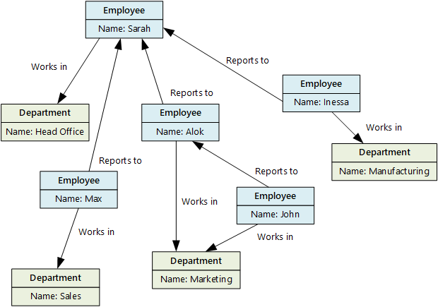

What is a graph database?
Stores entities centric around relationships
Enables applications to perform queries traversing a network of nodes and edges
Notes:
Instructor notes
Graph databases enable you to store entities, but the main focus is on the relationships that these entities have with each other. A graph database stores two types of information: nodes that you can think of as instances of entities, and edges, which specify the relationships between nodes.
Business requirements:
OLTP apps with highly correlated data
Easy updates to single or many objects
Flexible data modelling
Data requirements that evolve
Hierarchical data structures

Slide 14



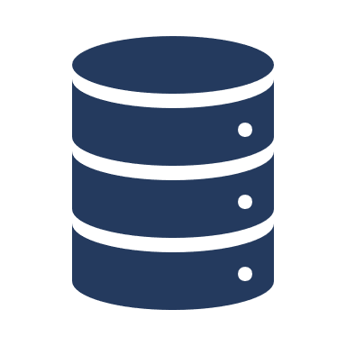


The Data Journey
Data Ingestion
Data Processing
Data Visualization
The process of obtaining and importing data for immediate use or storage in a database
Takes the data in its raw form, cleans it, and converts it into a more meaningful format
Query the data and create graphical representations of information and data
ETL
Extract, Transform, and Load
IoT Devices
Queries
Financial Transactions
ELT
Extract, Load, and Transform
Point-of-Sale
Data
Visualizations
Notes:
Ingestion is the process of importing data which might come in the form of a stream or in batches.
Data processing takes the data in its raw form, cleans it, and converts it into a more meaningful format.
ETL stands for *Extract, Transform, and Load*. The raw data is retrieved and transformed before being saved. The extract, transform, and load steps can be performed as a continuous pipeline of operations. It is suitable for systems that only require simple models, with little dependency between items.
The data processing engine can take an iterative approach, retrieving and processing the data from storage, before writing the transformed data and models back to storage. ELT (Extract, Load and Transform) is more suitable for constructing complex models that depend on multiple items in the database, often using periodic batch processing.
Data visualization is the graphical representation of information and data.

Slide 15
Explore data analytics
Descriptive
Diagnostic
Predictive
Prescriptive
Cognitive
Notes:
Instructor notes
Descriptive Analytics
The world of analytics, is evolving from the typical “Descriptive Analytics”, which is all about – What is happening in my business?
Diagnostic Analytics
The data insights, provided by descriptive analytics, are needed to provide the answer to: , “Why it is happening in your business”, which is often referred to analyzing root cause, or “Diagnostic Analytics”
Both, Descriptive and Diagnostic Analytics, is seen as a workload which is primarily providing a reactive response --- from what is happening, why is it happening, to what I am I going to do about it?
Predictive Analytics
By building out predictive patterns on top of your data, by utilizing the data findings from Descriptive, Diagnostic and Predictive data, you’ll be able to identify what is based on what you get from descriptive and diagnostic analytics and used to find answers to the question of what is likely to happen in the future based on previous trends and patterns?
Prescriptive Analytics
Techniques used to provide a predictive insights into your data, is commonly introduced by building out machine learning models, to “predict” trends and give the answer to the very
When you get the findings from Descriptive, Diagnostic and Predictive analytics like what’s happened, the root cause behind that and what-might-happen in future, Prescriptive model utilizes those answers to help you determine the best course of action to choose to bypass or eliminate future issues.
Cognitive Analytics
Cognitive analytics combines a number of intelligent technologies like artificial intelligence, machine-learning algorithms, deep learning etc.to apply human brain like intelligence to perform certain tasks. Basically, this type of analytics is inspired by how the human brain processes information, draws conclusions and codifies instincts and experience into learning such as understanding not only the words in a text but the full context of what is being written or spoken.

Slide 16



SQL Server on Azure Virtual Machines
SQL Server on Virtual Machines is an IaaS solution that enables users to use full versions of SQL Server in the Cloud without having to manage any on-premises hardware.
Guaranteed compatibility to SQL Server on premises
Customer manages everything – OS upgrades, software upgrades, backups, replication
Pay for the server and licensing, not per database

Slide 17
Azure SQL Database
Azure SQL Database is a PaaS offering where users create a managed database server in the cloud, and then deploy the databases on the server.
Low-cost option with minimal administration
Best for new cloud projects with flexible application design
Supports systems with variable loads – scale up and down quickly without restarting
Single Database
Elastic Pool
Create and run a database server in the cloud and access the database through the server.
Multiple databases share the same resources, such as memory, storage, and processing power.

Slide 18


Azure SQL Managed Instance
Azure SQL Managed Instance allows you to pre-provision compute resources and deploy several individual managed instances up to your pre-provisioned compute level.
Automatic backups, software patching, database monitoring, and other administrative tasks
Near 100% compatibility with on-premises SQL Server
Supported by other Azure services
Single Instance
Instance Pool
One SQL Server instance, multiple databases.
Multiple instances share the same resources.

Slide 19
Azure SQL Managed Instance or Azure SQL Database
Azure SQL Managed Instance
Azure SQL Database
Single instance:
SQL Server surface area (vast majority)
Native virtual network support
Fully managed service
Instance pool:
Pre-provision compute resources for migration
Enables cost-efficient migration
Ability to host smaller instances (2Vcore)
Currently in public preview
Single database:
Hyperscale storage (up to 100TB)
Serverless compute
Fully managed service
Elastic pool:
Resource sharing between multiple databases to price optimize
Simplified performance management for multiple databases
Fully managed service

Slide 20
PostgreSQL, MySQL, MariaDB
Azure Database for PostgreSQL is a relational database service in the Microsoft cloud based on the PostgreSQL Community Edition database engine.
Azure Database for MySQL is a PaaS implementation of MySQL in the Azure cloud, based on the MySQL Community Edition.
Azure Database for MariaDB is an implementation of the MariaDB database management system adapted to run in Azure. It's based on the MariaDB Community Edition.
Notes:
Instructor notes
PostgreSQL is a hybrid relational-object database. You can store data in relational tables, but a PostgreSQL database also enables you to store custom data types, with their own non-relational properties.
MySQL started life as a simple-to-use open-source database management system. It is the leading open source relational database for *Linux, Apache, MySQL, and PHP* (LAMP) stack apps.
MariaDB is a newer database management system, created by the original developers of MySQL. The database engine has since been rewritten and optimized to improve performance. MariaDB offers compatibility with Oracle Database (another popular commercial database management system).

Slide 21
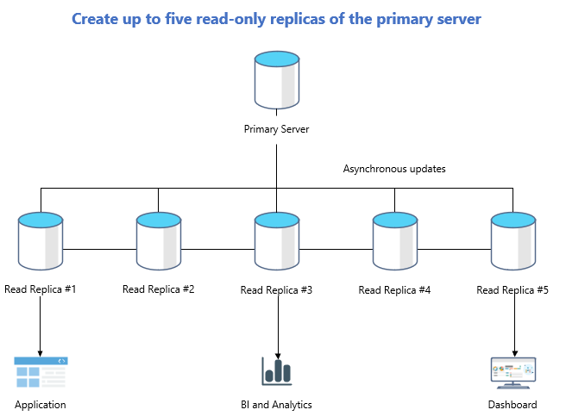
Azure DB – Read replicas
Read replicas help improve performance and scale of read-intensive workloads such as BI and analytics
Consider the read replica features in scenarios when delays in synching data between the primary and replicas are acceptable
Create a replica in a different Azure region from the primary for a disaster recovery plan, where a replica replaces the primary in cases of regional disasters
Data storage on replica servers grows automatically without impacting workloads

Slide 22
SQL Statement types
DML
DDL
DCL
Data Manipulation Language
Used to query and manipulate data
SELECT, INSERT, UPDATE, DELETE
Data Definition Language
Used to define database objects
CREATE, ALTER, DROP, RENAME
Data Control Language
Used to manage security permissions
GRANT, REVOKE, DENY
Notes:
Instructor notes
Explain that DML statements are by far the most common.

Slide 23
Use DML statements
Statement | Description
SELECT | Select/read from a table
INSERT | Insert new rows in a table
UPDATE | Edit/Update existing rows in a table
DELETE | Delete existing rows in a table
Notes:
Instructor notes

Slide 24
Example of SELECT statement
SELECT EmployeeId, YEAR(OrderDate) AS OrderYear
FROM Sales.Orders
WHERE CustomerId = 71
GROUP BY EmployeeId, YEAR(OrderDate)
HAVING COUNT(*) > 1
ORDER BY EmployeeId, OrderYear;

Slide 25
Example of CREATE statement
CREATE TABLE Mytable
(Mycolumn1 int NOT NULL PRIMARY KEY, Mycolumn2 VARCHAR(50) NOT NULL , Mycolumn3 VARCHAR(10) NOT NULL

Slide 26
Explore Azure Table storage
Key (Customer ID)
Value (Customer Data)
C1
AAAAA
BBB
101 Block Street
YY
999
888
C2
MM
NN
21 A Street
5 B Avenue
C3
DDD
EEE
FFF
111
222
66 C Road
Notes:
Instructor notes
All rows in a table must have a key, but apart from that the columns in each row can vary. Unlike traditional relational databases, Azure Table Storage tables have no concept of relationships, stored procedures, secondary indexes, or foreign keys. Data will usually be denormalized, with each row holding the entire data for a logical entity.

Slide 27
Explore Azure Blob storage
Block blobs
Page blobs
Append blobs
Has a maximum size of 4.7TB
Best for storing large, discrete, binary objects that changes infrequently
Each individual block can store up to 100MB of data
A block blob can contain up to 50000 blocks
Can hold up to 8TB of data
Is organized as a collection of fixed sized-512 byte pages
Used to implement virtual disk storage for virtual machines
The maximum size is just over 195GB
Is a block blob that is used to optimize append operations
Each individual block can store up to 4MB of data
Notes:
Instructor notes
Azure Blob storage is a service that enables you to store massive amounts of unstructured data, or Binary Large OBjects, in the cloud.
Azure currently supports three different types of blob:
Block blobs. A block blob is handled as a set of blocks. Each block can vary in size, up to 100 MB. A block blob can contain up to 50,000 blocks, giving a maximum size of over 4.7 TB. The block is the smallest amount of data that can be read or written as an individual unit. Block blobs are best used to store discrete, large, binary objects that change infrequently.
Page blobs. A page blob is organized as a collection of fixed size 512-byte pages. A page blob is optimized to support random read and write operations; you can fetch and store data for a single page if necessary. A page blob can hold up to 8 TB of data. Azure uses page blobs to implement virtual disk storage for virtual machines.
Append blobs. An append blob is a block blob optimized to support append operations. You can only add blocks to the end of an append blob; updating or deleting existing blocks isn't supported. Each block can vary in size, up to 4 MB. The maximum size of an append blob is just over 195 GB.

Slide 28






Explore Azure File storage
Azure File Storage creates files shares in the cloud and provides the ability to access the file shares from anywhere with an internet connection.
Uses Server Message Block 3.0 (SMB) to share files
Share up to 100 TB of data in a single storage account
Fully managed service – data is replicated locally and is encrypted at rest
File Share
Cloud Apps
On-Premises Apps
Cloud Apps

Slide 29

What is Azure Cosmos DB?
Azure Cosmos DB is a multi-model NoSQL database management system.
Cosmos DB manages data as a partitioned set of documents.
Real time access with fast read and write latencies.
Takes advantage of Azure scaling and storage capabilities.
Notes:
Relational databases store data in relational tables, but sometimes the structure imposed by this model can be too rigid, and often leads to poor performance unless you spend time implementing detailed tuning. Other models, collectively known as NoSQL databases exist. These models store data in other structures, such as documents, graphs, key-value stores, and column family stores.
Azure Cosmos DB is a multi-model NoSQL database management system.
Cosmos DB manages data as a partitioned set of documents. A document is a collection of fields, identified by a key.
The fields in each document can vary, and a field can contain child documents.
Many document databases use JSON (JavaScript Object Notation) to represent the document structure.
In this format, the fields in a document are enclosed between braces, { and }, and each field is prefixed with its name.
A document can hold up to 2 MB of data, including small binary objects.
If you need to store larger blobs as part of a document, use Azure Blob storage, and add a reference to the blob in the document.
Documents in a Cosmos DB database are organized into containers.
The documents in a container are grouped together into partitions. A partition holds a set of documents that share a common partition key.
You designate one of the fields in your documents as the partition key.
You should select a partition key that collects all related documents together.
This approach helps to reduce the amount of I/O (disk reads) that queries might need to perform when retrieving a set of documents for a given entity.
For example, in a document database for an ecommerce system recording the details of customers and the orders they've placed, you could partition the data by customer ID, and store the customer and order details for each customer in the same partition.
To find all the information and orders for a customer, you simply need to query that single partition.
There's a superficial similarity between a Cosmos DB container and a table in Azure Table storage: in both cases, data is partitioned and documents (rows in a table) are identified by a unique ID within a partition.
However, the similarity ends there. Unlike Azure Table storage, documents in a Cosmos DB partition aren't sorted by ID.
Instead, Cosmos DB maintains a separate index. This index contains not only the document IDs, but also tracks the value of every other field in each document.
This index is created and maintained automatically.
This index enables you to perform queries that specify criteria referencing any fields in a container, without incurring the need to scan the entire partition to find that data.

Slide 30
Query Azure Cosmos DB
COUNT( <fields_to_count> )
SUM( <numeric_fields> )
AVG( <numeric_fields> )
MAX( <numeric_fields> )
MIN( <numeric_fields> )
Aggregation Function Basics
SQL API examples
SELECT COUNT(*) FROM Products p
SELECT SUM(p.quantity) FROM Products p
WHERE p.expired = 0
SELECT AVG(p.price) AS ‘Average Price’
FROM Products p
SELECT p1.ID, p.Name, p1.Description, p1.Price FROM Products p1
WHERE p1.Price = (SELECT MIN(p2.Price) FROM Product p2)
Notes:
Instructor notes
Understand aggregate functions
You can use aggregate functions to summarize data in SELECT queries; you place aggregate functions in the SELECT clause. The SQL API query language supports the following aggregate functions:
COUNT(p). This function returns a count of the number of instances of field p in the result set. To count all the items in the result set, set p to a scalar value, such as 1.
SUM(p). This function returns the sum of all the instances of field p in the result set. The values of p must be numeric.
AVG(p). This function returns the mathematical mean of all the instances of field p in the result set. The values of p must be numeric.
MAX(p). This function returns the maximum value of field p in the result set.
MIN(p). This function returns the minimum value of field p in the result set.
Although the syntax of aggregate functions is similar to ANSI SQL, unlike ANSI SQL the SQL API query language doesn't support the GROUP BY clause; you can't generate subtotals for different values of the same field in a single query. You're able to include more than one aggregate function in the SELECT clause of your queries.
[Demo with the Volcanoes Data]
// Find the total number of volcanoes in Japan
SELECT COUNT(v) AS totalVolcanoesJapan
FROM v
WHERE v.Region = "Japan“
// Find the deepest volcano in Japan
SELECT MAX(v.Elevation) AS deepestVolcanoJapan
FROM v
WHERE v.Region = "Japan"

Slide 31
Azure services for the modern data warehouse
Azure Data Factory
Azure Data Lake
Azure Databricks
Azure HDInsight
Azure Synapse
Analytics
Notes:
Instructor notes
Azure Data Factory is a service that can ingest large amounts of raw, unorganized data from relational and non-relational systems, and convert this data into meaningful information.
Data Factory provides a scalable and programmable ingestion engine that you can use to implement complex hybrid extract-transform-load (ETL), extract-load-transform (ELT), and data integration projects.
Azure Data Lake is a collection of analytics and storage services that you can combine to implement a big data solution. It comprises three main elements: - Data Lake Store
- Data Lake Analytics
- HDInsight
Azure Databricks is an analytics platform optimized for the Microsoft Azure cloud services platform.
Designed with the founders of Apache Spark, Databricks is integrated with Azure to provide one-click setup, streamlined workflows, and an interactive workspace that enables collaboration between data scientists, data engineers, and business analysts.
Azure Synapse Analytics is generalized analytics service. You can use it to read data from many sources, process this data, generate various analyses and models, and save the results.
Azure HDInsight is a managed analytics service in the cloud. It's based on Apache Hadoop, a collection of open-source tools and utilities that enable you to run processing tasks over large amounts of data. HDInsight uses a clustered model, similar to that of Synapse Analytics.
HDInsight stores data using Azure Data Lake storage.
You can use HDInsight to analyze data using frameworks such as Hadoop Map/Reduce, Apache Spark, Apache Hive, Apache Kafka, Apache Storm, R, and more.

Slide 32
What is Azure Data Factory?
Azure Data Factory is described as a data integration service.
Retrieves data from more than one data source and converts it.
Filters out noise to keep interesting data
Work is defined as a pipeline operation – runs continuously as data is received
Notes:
Azure Data Factory is a service that can ingest large amounts of raw, unorganized data from relational and non-relational systems, and convert this data into meaningful information. Data Factory provides a scalable and programmable ingestion engine that you can use to implement complex hybrid extract-transform-load (ETL), extract-load-transform (ELT), and data integration projects.
Using Azure Data Factory, you can create and schedule data-driven workflows (called pipelines) that can ingest data from the disparate data stores used by the gaming company. You can build complex ETL processes that transform data visually with data flows or by using compute services such as Azure HDInsight, Azure Databricks, and Azure SQL Database. You can then publish the transformed data to Azure Synapse Analytics for business intelligence applications to consume.

Slide 33
What is Azure Data Lake Storage?
Azure Data Lake Storage is a repository of data for your modern data warehouse.
Organizes data into directories for improved file access.
Supports POSIX and RBAC permissions.
Compatible with the Hadoop Distributed File System
Notes:
Data Lake Storage organizes your files into directories and subdirectories for improved file organization. Blob storage can only mimic a directory structure.
Azure Data Lake Store provides granular security over data, using Access Control Lists. An Access Control List specifies which accounts can access which files and folders in the store. If you are more familiar with Linux, you can use POSIX (Portable Operating System Interface)-style permissions to grant read, write, and search access based on file ownership and group membership of users
Also, you can use directory permissions to enable granular Role-Based Access Control (RBAC) on your data.
Azure Data Lake Storage is compatible with the Hadoop Distributed File System (HDFS). Hadoop is highly flexible and programmable analysis service, used by many organizations to examine large quantities of data. All Apache Hadoop environments can access data in Azure Data Lake Storage Gen2.

Slide 34
What is Azure Databricks?
Azure Databricks is an Apache Spark-based platform that provides big data processing and streaming.
Simplifies the provisioning and collaboration of Apache spark-based analytical solutions.
Utilizes the security capabilities of Azure.
Integrates with a variety of Azure data platform services and Power BI.
Notes:
Instructor notes
Azure Databricks is an analytics platform optimized for the Microsoft Azure cloud services platform. Designed with the founders of Apache Spark, Databricks is integrated with Azure to provide one-click setup, streamlined workflows, and an interactive workspace that enables collaboration between data scientists, data engineers, and business analysts.
Apache Spark is a highly efficient data processing engine that can consume and process large amounts of data very quickly. There are a significant number of Spark libraries you can use to perform tasks such as SQL processing, aggregations, and to build and train machine learning models using your data.
Azure Databricks provides a graphical user interface where you can define and test your processing step by step, before submitting it as a set of batch tasks. You can create Databricks scripts and query data using languages such as R, Python, and Scala. You write your Spark code using notebooks. A notebook contains cells, each of which contains a separate block of code. When you run a notebook, the code in each cell is passed to Spark in turn for execution.

Slide 35
Describe data ingestion in Azure
ADF
PolyBase
SSIS
70
100
80
Heterogenous
File based
Heterogenous
Notes:
Instructor notes
Azure Data Factory is a data ingestion and transformation service that allows you to load raw data from many different sources, both on-premises and in the cloud.
As it ingests the data, Data Factory can clean, transform, and restructure the data, before loading it into a repository such as a data warehouse. Once the data is in the data warehouse, you can analyze it.
PolyBase is a feature of SQL Server and Azure Synapse Analytics that enables you to run Transact-SQL queries that read data from external data sources. PolyBase makes these external data sources appear like tables in a SQL database.
Using PolyBase, you can read data managed by Hadoop, Spark, and Azure Blob Storage, as well as other database management systems such as Cosmos DB, Oracle, Teradata, and MongoDB.
SQL Server Integration Services (SSIS) is a platform for building enterprise-level data integration and data transformations solutions.
You can use SSIS to solve complex business problems by copying or downloading files, loading data warehouses, cleaning and mining data, and managing SQL database objects and data. SSIS is part of Microsoft SQL Server.
Databricks can process data held in many different types of storage, including Azure Blob storage, Azure Data Lake Store, Hadoop storage, flat files, SQL databases, and data warehouses, and Azure services such as Cosmos DB. Databricks can also process streaming data. For example, you could capture data being streamed from sensors and other devices.

Slide 36


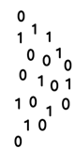


Describe components of Azure Data Factory
Linked Service
Triggers
@
Parameters
IR
Integration Runtime
Data Lake Store
Pipeline
CF
Control Flow
1
Activities
Azure Databricks
Dataset
Notes:
Instructor notes
Azure Data Factory can incorporate Azure Databricks notebooks into a pipeline. A pipeline can pass parameters to a notebook. These parameters can specify which data to read and analyze. The notebook can save the results, which the Azure Data Factory pipeline can use in subsequent activities.

Slide 37
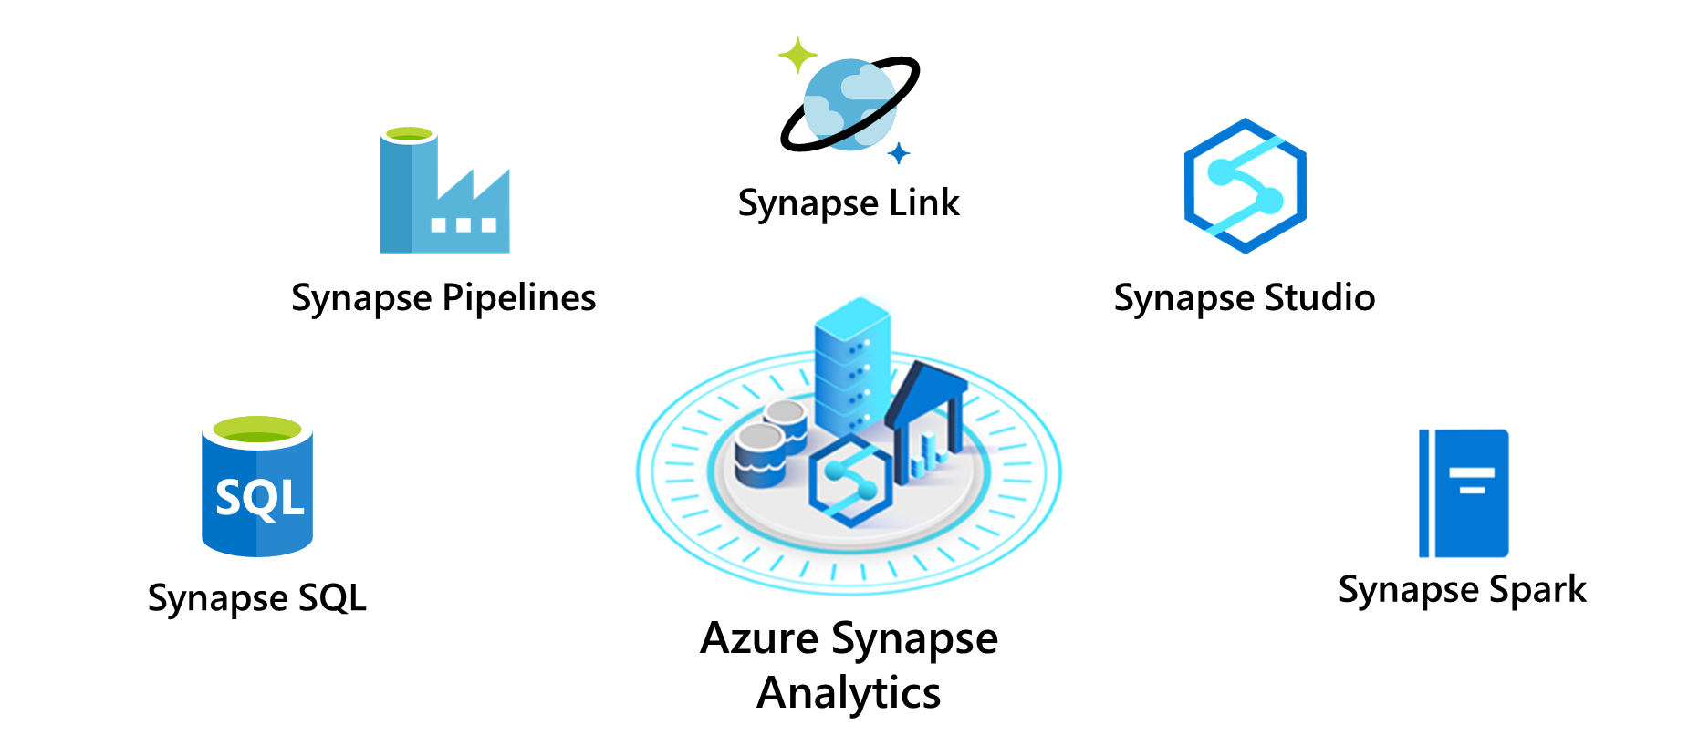
Explore Azure Synapse Analytics
Notes:
Instructor notes
- Synapse SQL pool: This is a collection of servers running Transact-SQL. Transact-SQL is the dialect of SQL used by Azure SQL Database, and Microsoft SQL Server. You write your data processing logic using Transact-SQL.
- Synapse Spark pool: This is a cluster of servers running Apache Spark to process data.
You write your data processing logic using one of the four supported languages: Python, Scala, SQL, and C# (via .NET for Apache Spark). Spark pools support Azure Machine Learning through integration with the SparkML and AzureML packages.
- Synapse Pipelines: A Synapse pipeline is a logical grouping of activities that together perform a task.
The activities in a pipeline define actions to perform on your data. For example, you might use a copy activity to transform data from a source dataset to a destination dataset. You could include activities that transform the data as it is transferred, or you might combine data from multiple sources together.
- Synapse Link: This component allows you to connect to Cosmos DB. You can use it to perform near real-time analytics over the operational data stored in a Cosmos DB database.
- Synapse Studio: This is a web user interface that enables data engineers to access all the Synapse Analytics tools. You can use Synapse Studio to create SQL and Spark pools, define and run pipelines, and configure links to external data sources.

Slide 38
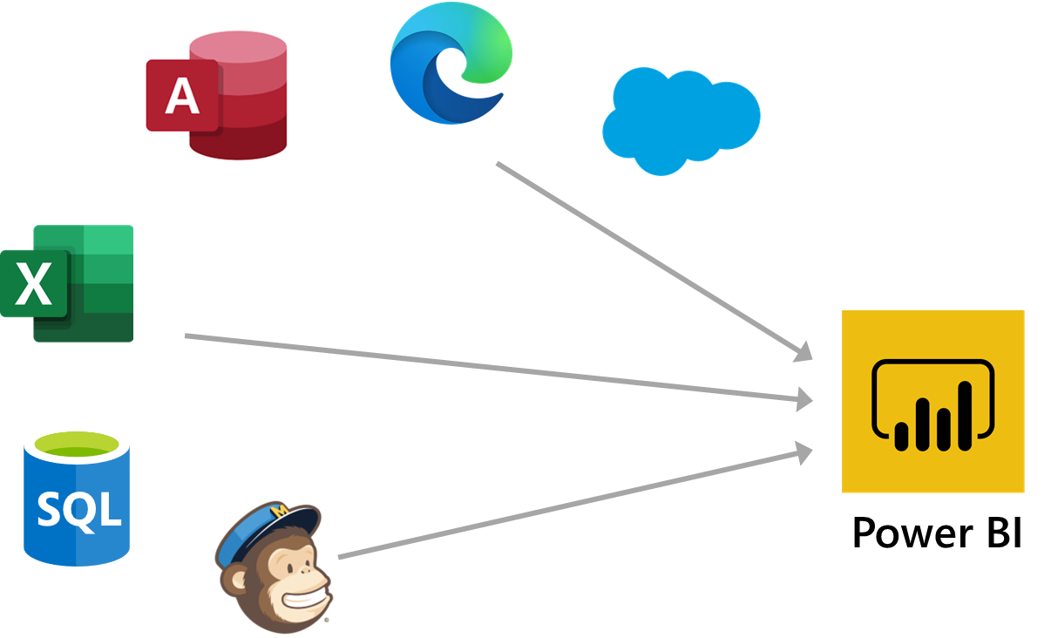
What is Power BI?
Notes:
Instructor notes
Here are the basic building blocks in Power BI:
* Visualizations
* Datasets
* Reports
* Dashboards
* Tiles
1. Bring data into Power BI Desktop as a dataset and create a report.
2. Publish to the Power BI service, where you can create new tiles and visualizations or build dashboards.
3. Share dashboards with others, especially people who are on the go.
4. View and interact with shared dashboards and reports in Power BI Mobile apps.

Slide 39
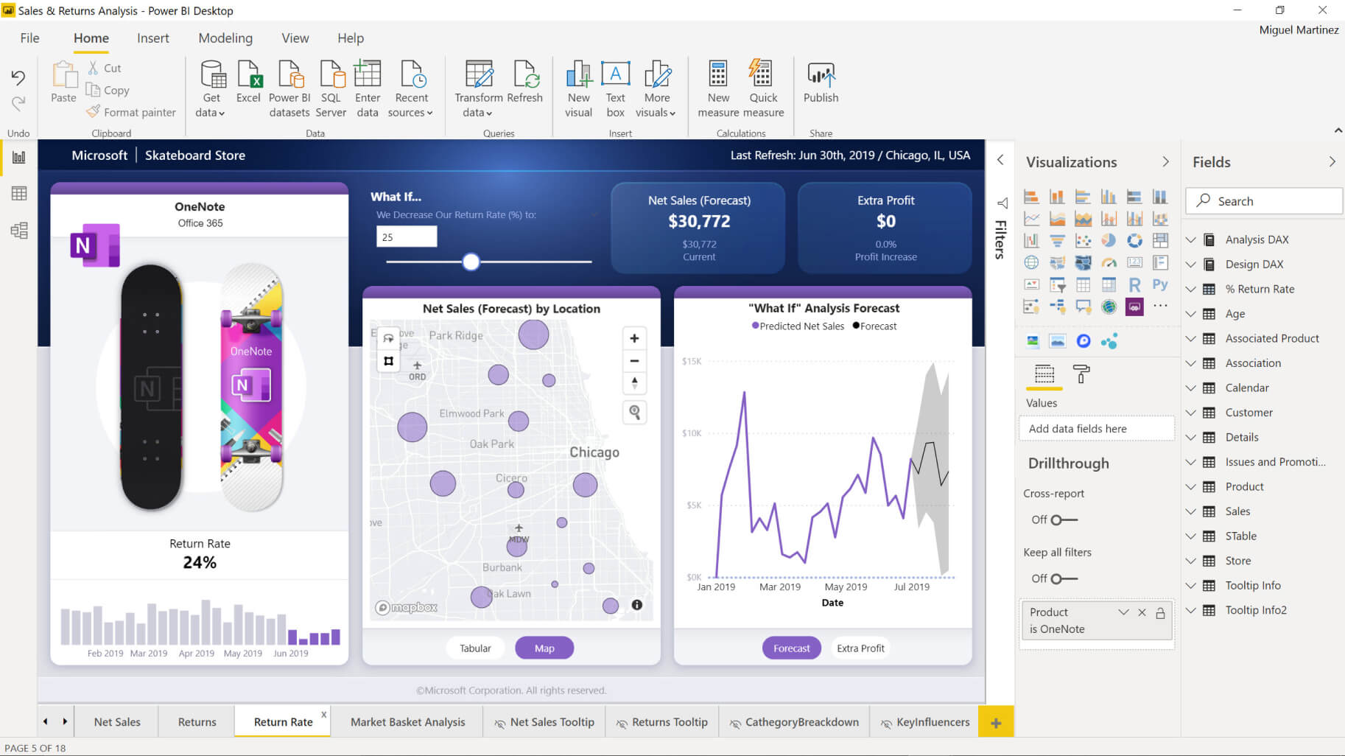
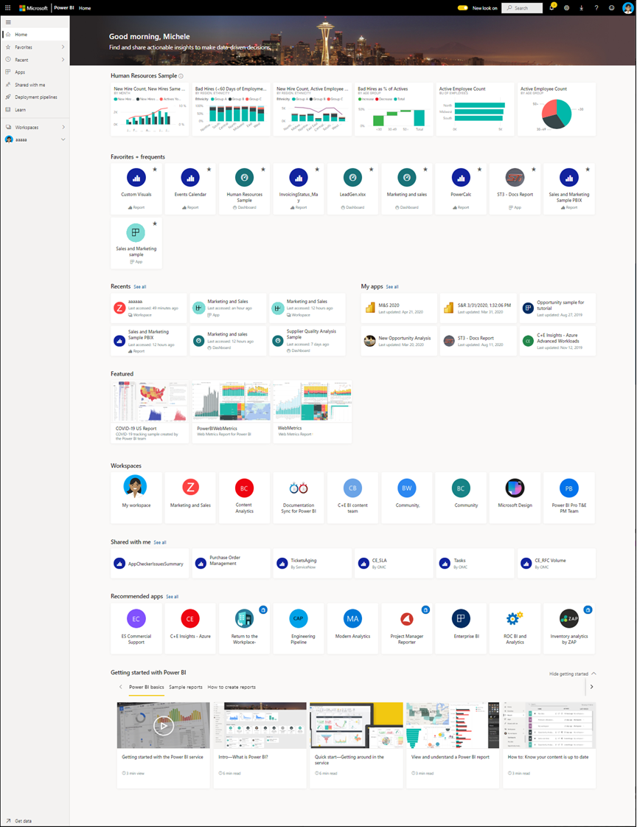
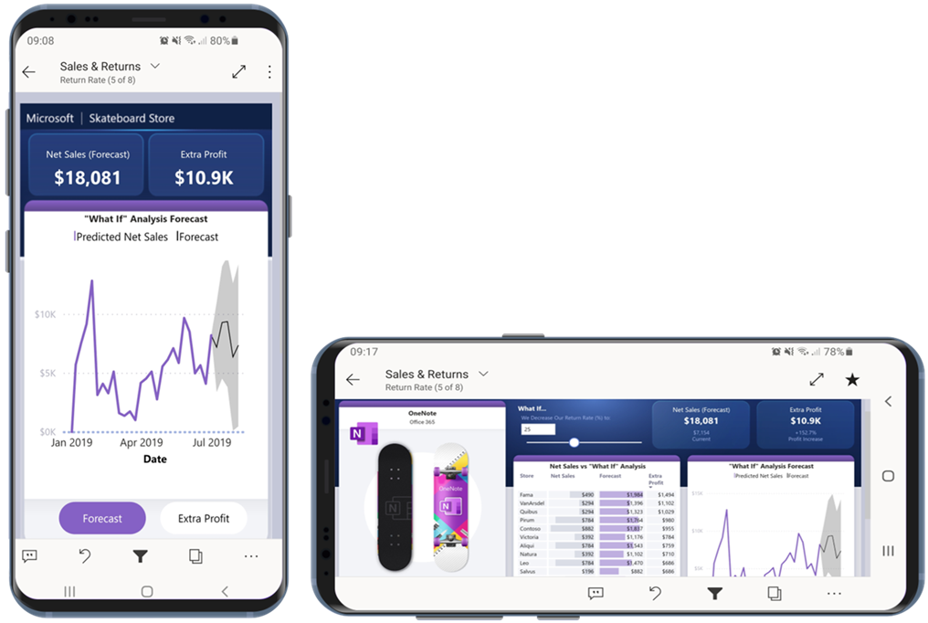
How can you use Power BI?
Power BI Desktop
Power BI Service
Animated Slide
Power BI Mobile
Notes:
Instructor notes
There are a few elements of Power BI, with three being:
The windows application called ‘Power BI Desktop’
The Online SaaS Service called ‘Power BI Service’
The Power BI apps for Windows, iOS and Android.
There is also the Power BI Report Builder, to create reports to share via the Power BI Service
and the Power BI Report Server, an on-prem server where you can publish your Power BI reports after creating it via Power BI Desktop

Slide 40
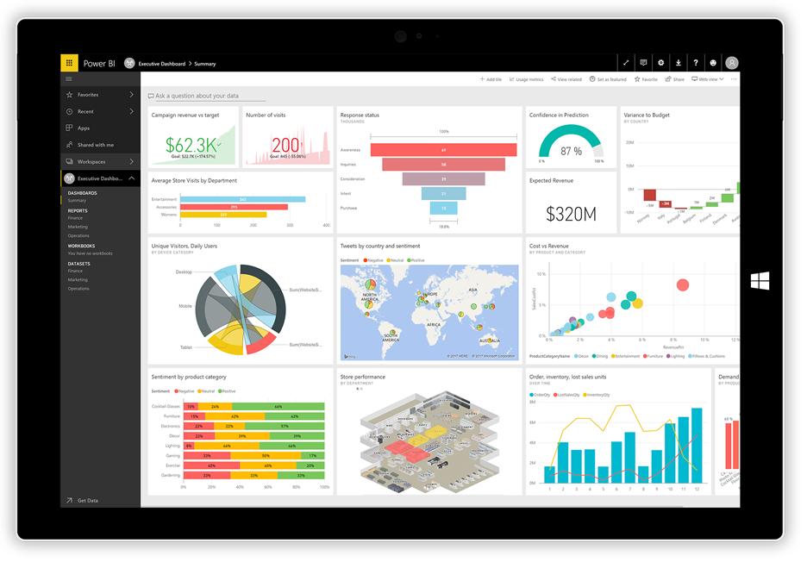
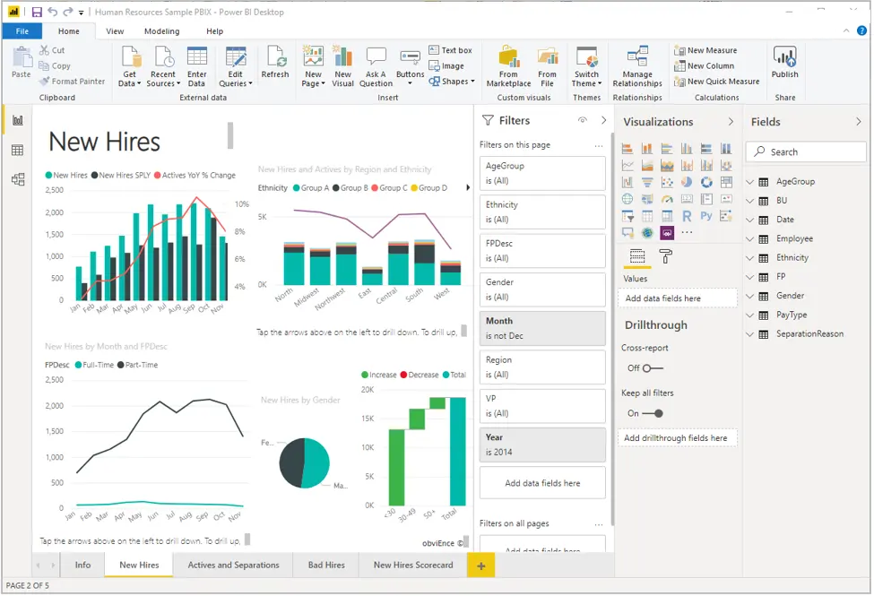
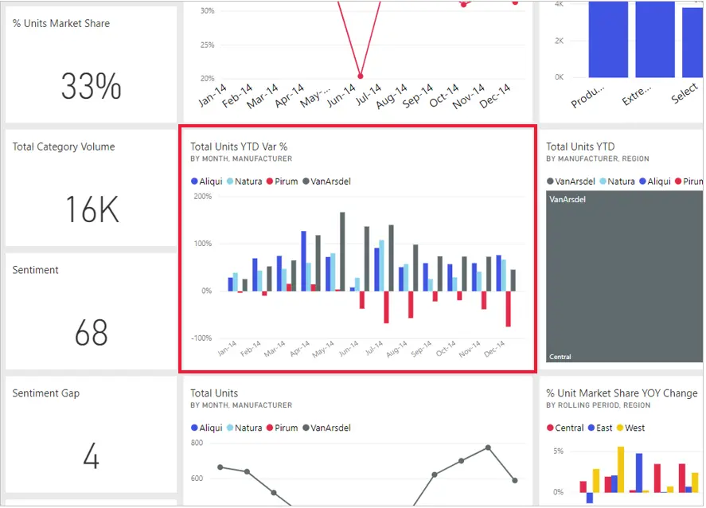
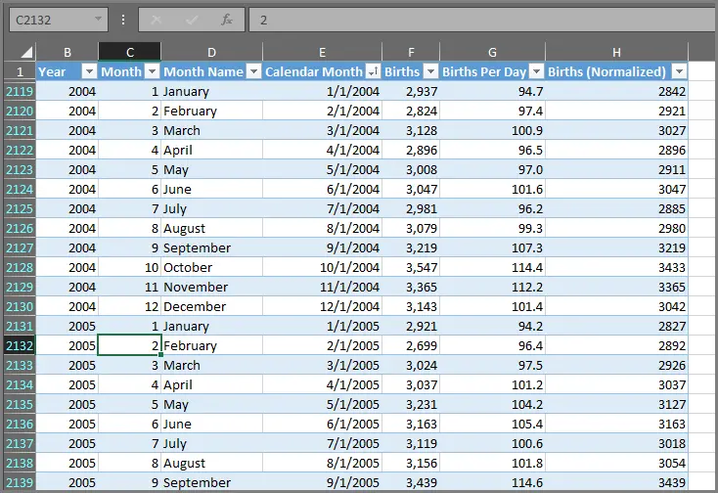
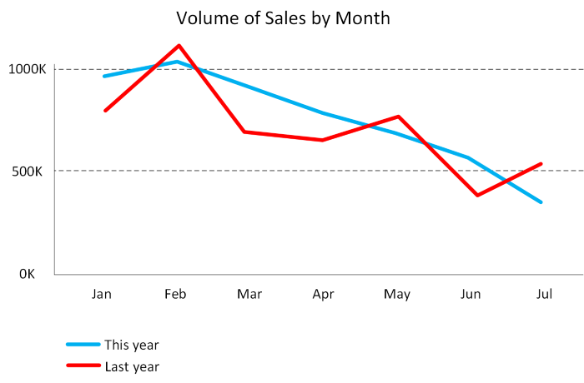
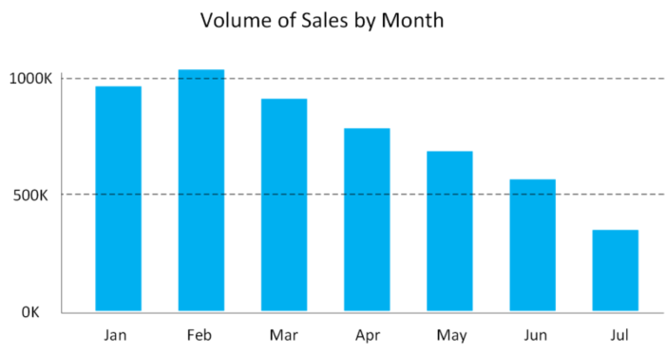
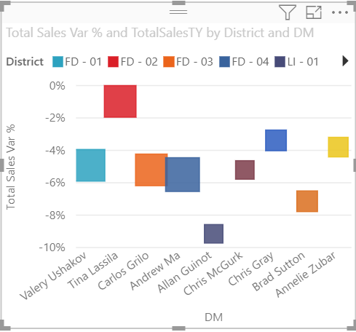
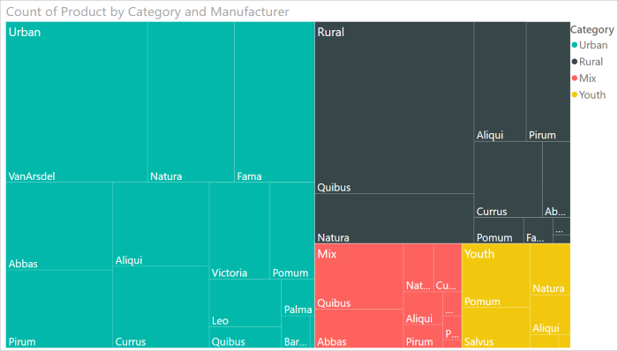
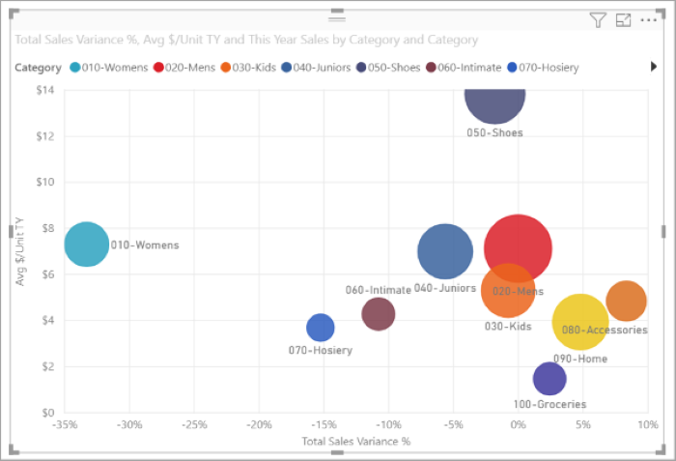
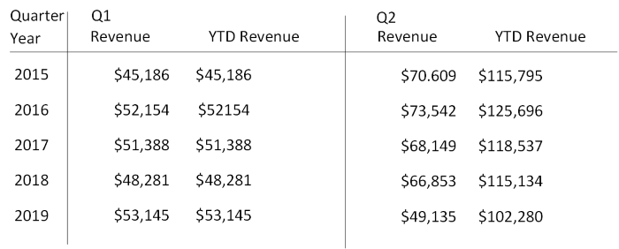
The anatomy of a Power BI app
Visualizations
Datasets
Reports
Dashboards
Animated Slide
Tiles
Notes:
Visualization (sometimes also referred to as a visual) is a visual representation of data, like a chart, a color-coded map, or other interesting things you can create to represent your data visually. Power BI has all sorts of visualization types, and more are coming all the time.
A dataset is a collection of data that Power BI uses to create its visualizations. Datasets can also be a combination of many different sources, which you can filter and combine to provide a unique collection of data (a dataset) for use in Power BI.
In Power BI, a report is a collection of visualizations that appear together on one or more pages. Just like any other report you might create for a sales presentation or write for a school assignment, a report in Power BI is a collection of items that are related to each other.
When you're ready to share a single page from a report, or a collection of visualizations, you create a dashboard. Much like the dashboard in a car, a Power BI dashboard is a collection of visuals from a single page that you can share with others. Often, it's a selected group of visuals that provide quick insight into the data or story you're trying to present.
In Power BI, a tile is a single visualization on a report or a dashboard. It's the rectangular box that holds an individual visual. In the following image, you see one tile, which is also surrounded by other tiles.

